Slide 1

Importing Datasets

Slide 2
Objectives
Read data using Python's Pandas package
Demonstrate how to import and export data in Python
Importing Datasets

Slide 3
Importing and Exporting Data in Python
Importing data: process of loading and reading data into Python from various resource
What are important properties?
  Resource format: file format( .csv, . Xlsx, .json,...
  Located: resource path
    C:/data/yourdata.csv
    https://archive.ics.uci.edu/ml/machine-learning-databases/autos/imports-85.names
Importing Datasets

Slide 4
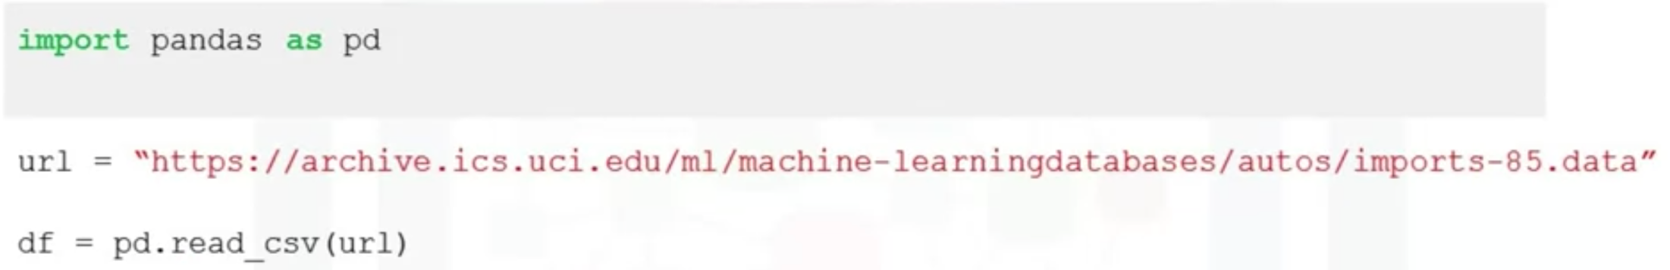
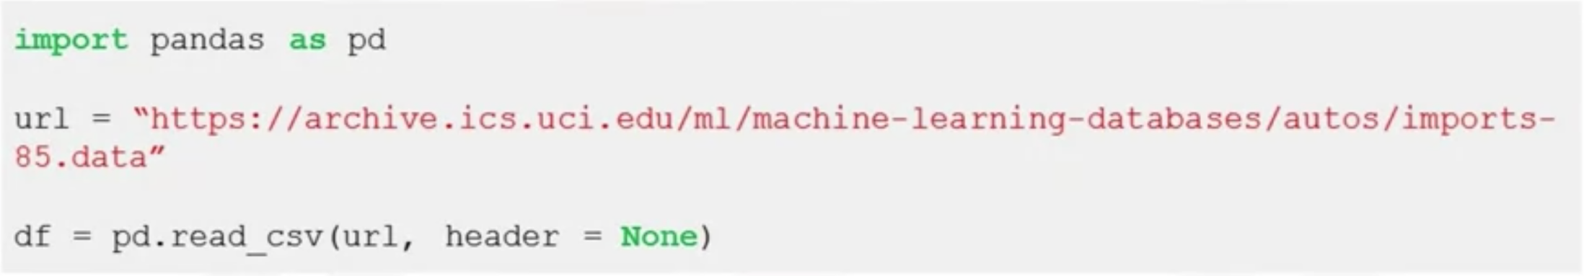
Importing and Exporting Data in Python
Importing a CSV into Python
Importing a CSV without a header
Importing Datasets

Slide 5
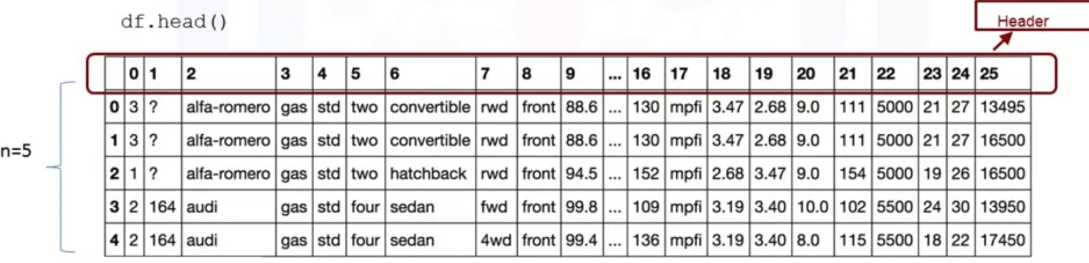
Importing and Exporting Data in Python
Printing the dataframe in Python
  df.head(n): show the first n rows of data frame
  df.tail(n): show the bottom n rows of data frame
We printed out the first five rows of data
  Pandas automatically set the column header
  Difficult to work with the meaningful column names
Importing Datasets

Slide 6
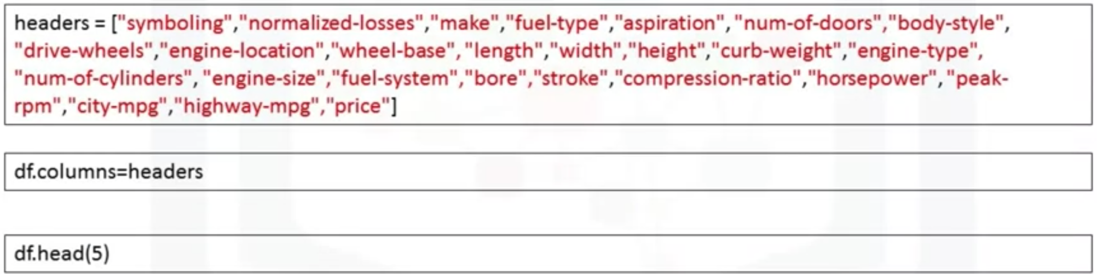
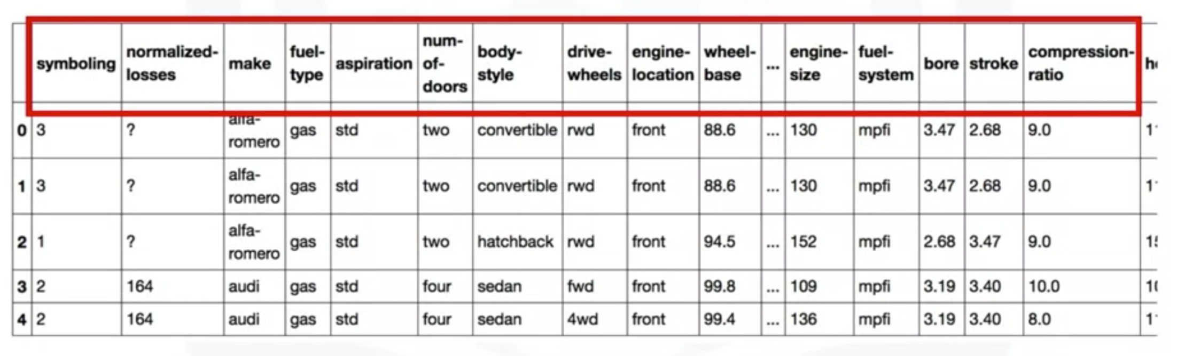
Importing and Exporting Data in Python
Replace default header: df.columns= headers
Importing Datasets

Slide 7

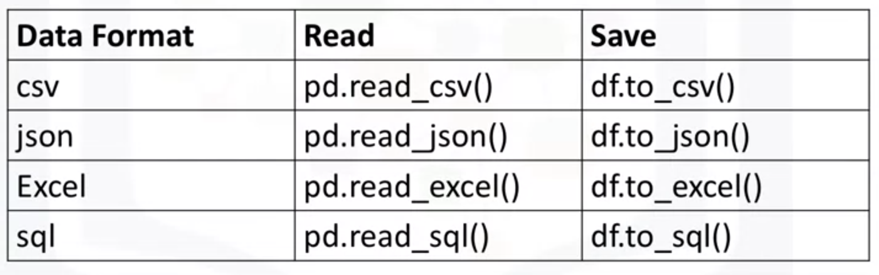
Importing and Exporting Data in Python
Saving data
Exporting to different formats in Python
Importing Datasets

Slide 8
Getting Started Analyzing Data in Python
Understand your data before you begin any analysis
Should check:
  Data types
  Data distribution
Locate potential issues with the data: the wrong data type of features which may need to be resolved later on.
Importing Datasets

Slide 9
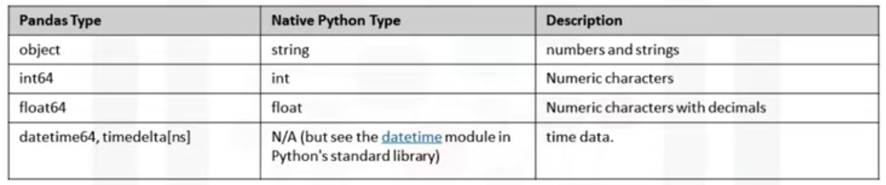
Getting Started Analyzing Data in Python
Data type in Pandas and pure Python
Why do you need to check data types?
  Pandas automatically assign types based on the encoding it detects from the original data table.
  Compatibility with Python methods
Importing Datasets

Slide 10
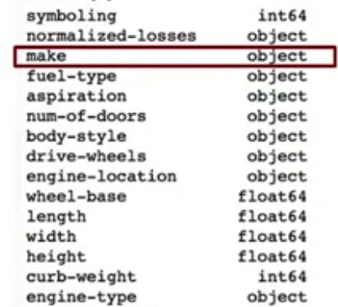
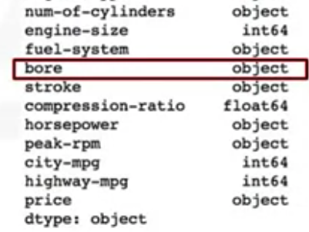
Getting Started Analyzing Data in Python
In Pandas, you can use dataframe.dtypes to check data type: df.types
Importing Datasets

Slide 11
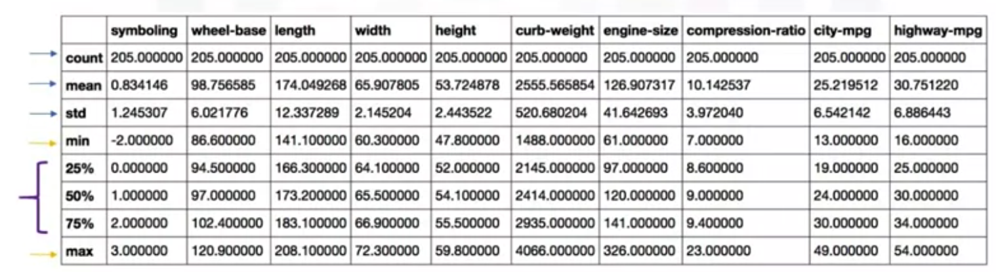
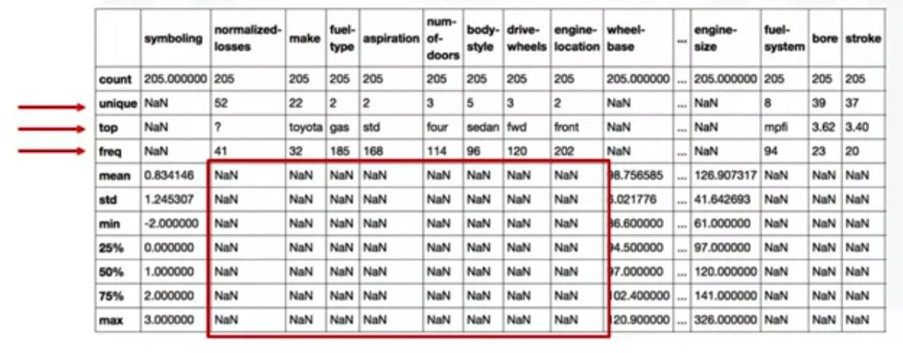
Getting Started Analyzing Data in Python
df.describe(): returns a statistical summary
df.describe(include=“all”): returns a full statistical summary
Importing Datasets

Slide 12
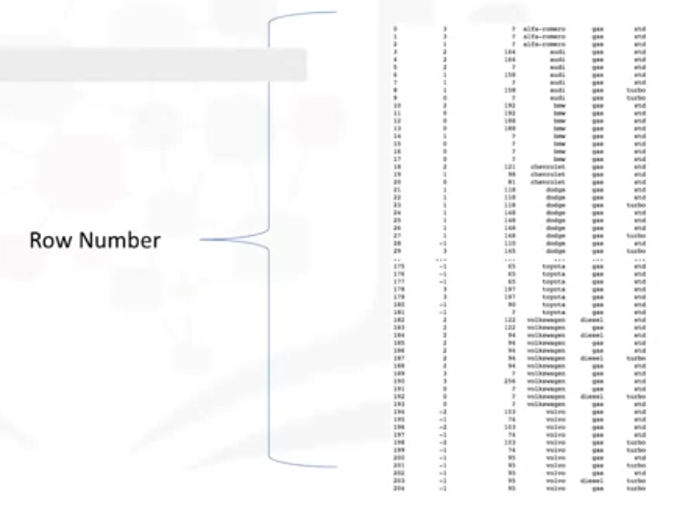
Getting Started Analyzing Data in Python
df.info(): concise summary of your DataFrame
Importing Datasets

Slide 13
Summary
Read data using Python's Pandas package
Demonstrate how to import and export data in Python
Importing Datasets

Slide 14
Q & A
Importing Datasets

